Slide 1

Bank marketing (campaign)
JSSN Group
15 Aug. 2021

Slide 2
Group members names
 | Name | Email | Country | University/Company | Specialization
1 | Peter Okwukogu | peter.okwukogu@gmail.com | Nigeria | Colab Kaduna | Data Science
2 | Almudena Zhou Ramírez | almu180@gmail.com | Spain | UNED | Data Science
3 | Shoug Alotaibi | Shouga.1417@gmail.com | Saudi Arabia | KFUPM | Data Science
4 | Mha Luqman Salameh | mahasa179@gamil.com | Jordan | AABU | Data Science
.

Slide 3
Agenda
Business Problem
EDA Recommendations
Model Building
Model Selection
Performance Metrics
Recommendations

Slide 4
Business Problem
ABC Bank wants to sell it's term deposit product to customers. The bank aspire to use an ML Model to focus on shortlisted customers which they are often interested in bank's campaigns. The Bank desires to save time costs for the employees and resources in these campaigns that will achieve only with marvelous ML model.
Deposit for client funds transferred to a specific creation account. After that, the money will be returned to the depositor with interest usually calculated at the end of the term, with closing.But some banks offer money with interest capitalization - daily and monthly.
.

Slide 5
EDA Recommendations
-Depending on values of y (yes or no ) we used as ML models :
Logistic Regression ,Bagging Classifier, XGBOOST and Decision Tree.
- After an automatic feature selection, we decided to not apply it since it didn’t improve the performance of the model.
- F1 score was used. The models have been trained with 80% of the data and validated in the rest.
.

Slide 6
Model Building & Selection
We worked on four different models:
Xgboost
Bagging Classifier
Logistic Regression
Decision Tree Classifier
.

Slide 7
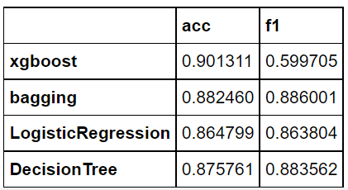
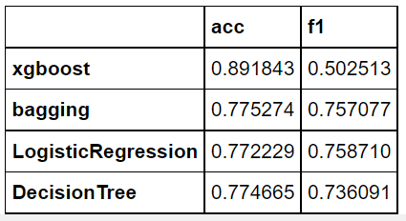
Model Building & Selection
We tested our model one with duration and one time without duration. Here are the results of the accuracy and F1 score for each model.
With duration: Without duration:
.

Slide 8
Final Recommendations
As we can see, the models are much better with the duration column. Also, it seems like the undersampling goes better in terms of f1, but slighly worse with accuracy.
Apart from that, all the models are better than choosing randomly.
Taking account all this, we will choose the logistic regression as our model, since it is the simpliest one without loosing significantly in any of the chosen metrics.
.

Slide 9
Thank You

